Slide 1
Read Before Use
Thanks for downloading
01
Download and install Monserrat Font - Raleway Light - Lobster 1.4 before editing this template to ensure it looks just as you found it on PPThemes.com. Otherwise, the fonts will change, altering the design of your template.
02
Someone once said, "Creativity is the key to future success." Feel free to make this template your own—unleash your creativity by customizing the colors, icons, and images to match your brand!
03
Some images may be missing, giving you the freedom to use your own. The images used were sourced from www.pexels.com, where you can find free alternatives. Feel free to replace them with your own!
04
Enjoy! If you like this template, don’t forget to leave a comment and share it on your social media—someone else might find it helpful too. And remember to check back often! We’ll keep uploading new options to help you keep impressing your audience.

Slide 2
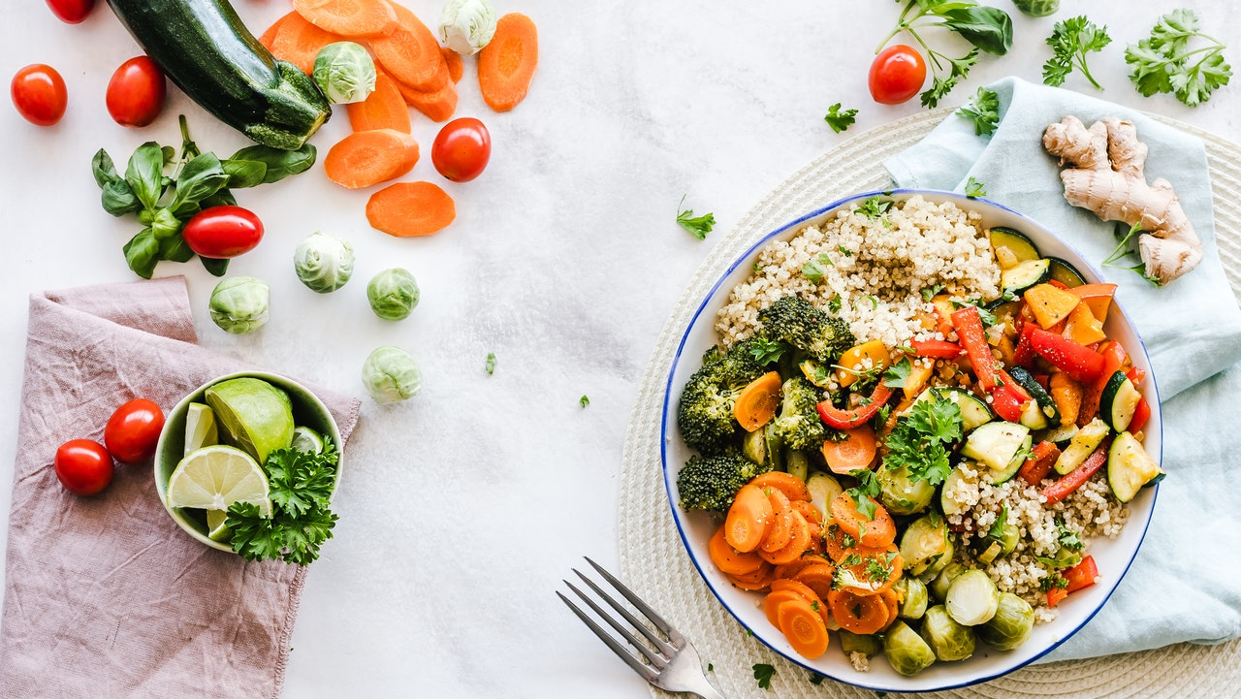
May is international
MEDITERRANEAN DIET
Month
Ppthemes.com

Slide 3





Slide 4
FOOD INFOGRAPHIC
FACTOR 01
You can do whatever you want, go a impress your audience with an amazing presentation
FACTOR 02
You can do whatever you want, go a impress your audience with an amazing presentation
FACTOR 03
You can do whatever you want, go a impress your audience with an amazing presentation
FACTOR 04
You can do whatever you want, go a impress your audience with an amazing presentation
FACTOR 05
You can do whatever you want, go a impress your audience with an amazing presentation
.

Slide 5
Our Signature Dish
Balanced Diet
You can do whatever you want, go a impress your audience with an amazing presentation
Better Taste
You can do whatever you want, go a impress your audience with an amazing presentation
.
Food Consumption
You can do whatever you want, go a impress your audience with an amazing presentation

Slide 6
CORE VALUE
YOUR SUBTITLE HERE
DINING
You can do whatever you want, go a impress your audience with an amazing presentation
BALANCE
You can do whatever you want, go a impress your audience with an amazing presentation
COOKING
You can do whatever you want, go a impress your audience with an amazing presentation

Slide 7
SLIDE FOR IMAGES
YOUR SUBTITLE HERE

Slide 8

MOBILE DEVICES
YOUR SUBTITLE HERE

Slide 9

LAPTOP FEATURES APP PROJECT
YOUR SUBTITLE HERE
DINING
You can do whatever you want, go a impress your audience with an amazing presentation
BALANCE
You can do whatever you want, go a impress your audience with an amazing presentation
COOKING
You can do whatever you want, go a impress your audience with an amazing presentation

Slide 10
OUR SERVICES
FACTOR 01
FACTOR 02
Cooking food properly helps to avoid food poisoning. Most raw foods feature.
Cooking food properly helps to avoid food poisoning. Most raw foods feature.
FACTOR 03
FACTOR 04
Cooking food properly helps to avoid food poisoning. Most raw foods feature.
Cooking food properly helps to avoid food poisoning. Most raw foods feature.

Slide 11
Your Subtitle Here
HOW TO ORDER
Step 01
Step 02
Step 03
You can do whatever you want, go a impress your audience with an amazing presentation
You can do whatever you want, go a impress your audience with an amazing presentation
You can do whatever you want, go a impress your audience with an amazing presentation

Slide 12
ANY
QUESTIONS?

Slide 13
THANKS
Ppthemes.com

Slide 14
THANKS FOR DOWNLOADING THESE TEMPLATES!
Find even more free templates at
https://ppthemes.com/ / www.slidesgratis.com
Premium Templates: https://www.pptbundle.com/
If you loved the template and want to show your support, I’d really appreciate it if you followed me on social media!! ☺
https://www.instagram.com/ppthemes/
https://www.facebook.com/ppthemess
https://www.youtube.com/@Ppthemes
https://www.tiktok.com/@Ppthemes
Images used in this template are courtesy of Freepik and Pixabay.

