Slide 1
Read Before Use
Thanks for downloading
01
Download and install Poppins font and Monserrat Font before editing this template to ensure it looks just as you found it on PPThemes.com. Otherwise, the fonts will change, altering the design of your template.
02
Someone once said, "Creativity is the key to future success." Feel free to make this template your own—unleash your creativity by customizing the colors, icons, and images to match your brand!
03
Some images may be missing, giving you the freedom to use your own. The images used were sourced from www.pexels.com, where you can find free alternatives. Feel free to replace them with your own!
04
Enjoy! If you like this template, don’t forget to leave a comment and share it on your social media—someone else might find it helpful too. And remember to check back often! We’ll keep uploading new options to help you keep impressing your audience.

Slide 2
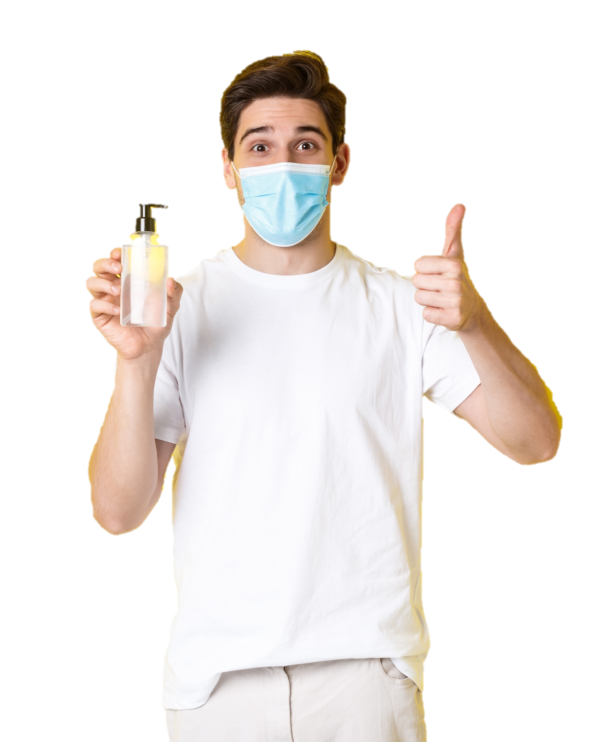
AGAINST
COVID-19
LET’S
FIGHT
TOGETHER
By: Your Name
Ppthemes.com

Slide 3
COVID-19 SLIDE
A business plan is a written document that describes in detail how a business—usually a new one—is going to achieve its goals. A business plan lays out a written plan from a marketing, financial and operational viewpoint.
Business plans are important to allow a company to lay out its goals and attract investment. They are also a way for companies to keep themselves on track going forward. Although they're especially useful for new companies, every company should have a business plan.

Slide 4
2019-nCov
CORONAVIRUS
Symptoms
High fever
Cough
Sore throat
Head ache
Contagion
Air by cough
or sneeze
Personal contact
Contaminated
objects
Animal contact
Prevention
Wash your
hands often
Wear a face
mask
Avoid contact
with sick people
Always cover
your cough
or sneeze

Slide 5
COVID-19 SLIDE
A business plan is a written document that describes in detail how a business, usually a new one, is going to achieve its goals. A business plan lays out a written plan from a marketing, financial and operational viewpoint.

Slide 6
CORONAVIRUS
PREVENTION
2019-nCOV
WEAR FACE
MASK
AVOID CONTACT
WITH ANIMALS
GO TO THE
DOCTOR
WASH YOUR
HANDS
TRANSMISSION
HUMAN
CONTACT
CONTAMINATED
OBJECTS
AIR
TRANSMISSION
SYMPTOMS
FEVER
COUGH
HEADACHE

Slide 7
COVID-19 SLIDE
A business plan is a written document that describes in detail how a business, usually a new one, is going to achieve its goals. A business plan lays out a written plan from a marketing, financial and operational viewpoint.

Slide 8
YOUR SUBTITLE HERE
COVID-19 SLIDE
A business plan is a written document that describes in detail how a business—usually a new one—is going to achieve its goals. A business plan lays out a written plan from a marketing, financial and operational viewpoint. Business plans are important to allow a company to lay out its goals and attract investment. They are also a way for companies to keep themselves on track going forward.
Although they're especially useful for new companies, every company should have a business plan. Ideally, a company would revisit the plan periodically to see if goals have been met or have changed and evolved.

Slide 9
CORONAVIRUS
WHAT IS IT?
CONTAGION
FEVER
HEADACHE
MUSCLE
PAIN
COUGH
DYSPNEA
HUMAN
CONTACT
AIR
TRANSMISSION
CONTAMINATED
OBJECTS
PREVENTION
ABOUT
Coronavirus (CoV) are a large family of viruses that cause illness ranging from the common cold to more severe diseases such as Middle Eastern Respiratory Syndrome (MERS-CoV) and Severe Acute Respiratory Syndrome (SARS-CoV). Coronaviruses are zoonotic, meaning they are transmitted between animals and people.
WASHING
HANDS
USE MASK
AVOID CONTACT
WITH ANIMALS

Slide 10
COVID-19 SLIDE
A business plan is a written document that describes in detail how a business, usually a new one, is going to achieve its goals. A business plan lays out a written plan from a marketing.
Market Opportunity

Slide 11
2019-nCov
Symptoms
Prevention
Statistics
Coronaviruses are zoonotic, meaning they are transmitted between animals and people.
Wash your hands
Use an alcohol-based
sanitizer
What is it?
Sore Throat
Confusion
Coronavirus (CoV) are a large family of viruses that cause illness ranging from the common cold to more severe diseases such as Middle Eastern Respiratory Syndrome (MERS-CoV) and Severe Acute Respiratory Syndrome (SARS-CoV).
Cover your cough or
use a tissue
Avoid touching your
face
Headaches
Shortness of
Breath
Avoid contact with
sick people
Disinfect frequently
touched objects
Who is at risk?
Cough
Fever
Children
Seniors

Slide 12
COVID-19 SLIDE
A business plan is a written document that describes in detail how a business, usually a new one, is going to achieve its goals.

Slide 13
2019-nCov
CHINA
THAILAND
US
AUSTRALIA
JAPAN
MALAYSIA
SINGAPORE
TAIWAN
FRANCE
SOUTH KOREA
VIETNAM
CANADA
NEPAL
Wuhan Coronavirus
TRANSMISSION
AIR
CONTAMINATED
OBJECTS
ANIMAL
CONTACT
HUMAN
CONTACT
SYMPTOMS
PREVENTION
FATIGUE
FEVER
Wear a face
mask
Cover mouth and
nose when coughing
Wash your hands
frequently
MARKET
SHORTNESS
OF BREATH
DRY COUGH
Seek medical attention
if symptoms appear
Avoid contact with
animals
Avoid public and
crowded places

Slide 14
AGAINST
COVID-19
THANKS
By: Your Name
Ppthemes.com

Slide 15
THANKS FOR DOWNLOADING THESE TEMPLATES!
Find even more free templates at
https://ppthemes.com/ / www.slidesgratis.com
Premium Templates: https://www.pptbundle.com/
If you loved the template and want to show your support, I’d really appreciate it if you followed me on social media!! ☺
https://www.instagram.com/ppthemes/
https://www.facebook.com/ppthemess
https://www.youtube.com/@Ppthemes
https://www.tiktok.com/@Ppthemes
Images used in this template are courtesy of Freepik and Pixabay.

